Slide 1
Unit-6
Advanced Algorithm and Analysis

Slide 2
Contents…
Backtracking
  N-Queen's Problem
P & NP problems,
NP-hard problems
NP-complete problems
Approximation hard problems
  Traveling salesman problem

Slide 3
Backtracking
General Method-
  Backtracking is one of the techniques that can be used to solve the problem.
  It is a general algorithm for finding all solutions to some computational problems.
  Solutions satisfying some constraints can be solved by using backtracking.
  It is an algorithmic-technique
    Used for solving problems recursively by trying to build a solution incrementally,
    one piece at a time,
    removing those solutions that fail to satisfy the constraints of the problem.

Slide 4
General Method
Backtracking is a systematic method of trying out various sequences of decisions until we find out that works.
Backtracking name itself suggests that we are going back and coming forward.
If it satisfies the condition, then return success, else we go back again.
There are three types of problems in backtracking –
  Decision Problem –we search for a feasible solution.
  Optimization Problem –we search for the best solution.
  Enumeration Problem –we find all feasible solutions.

Slide 5
Backtracking -The general method
Solution by using backtracking method is expressible as an n-tuple (x1,x2,…..,xn).
It uses Brute Force approach
It states that for the given problem, we try to make all the possible solutions and pick out the best solution from all the desired solutions.
Backtracking requires all solutions satisfying a set of constraints.
Two categories of constraints:
  Explicit constraint- take values from given set.
  Implicit constraint-determine which tuple satisfy the criterion function.

Slide 6
Backtracking - state space tree
Backtracking algorithms determine problem solutions by systematically searching the solution space for the given problem instance.
Solution of problem is represented by using a tree organization for the solution space.
The tree organization of the solution space is referred to as the state space tree.
For given solution space many tree organizations may be possible.

Slide 7
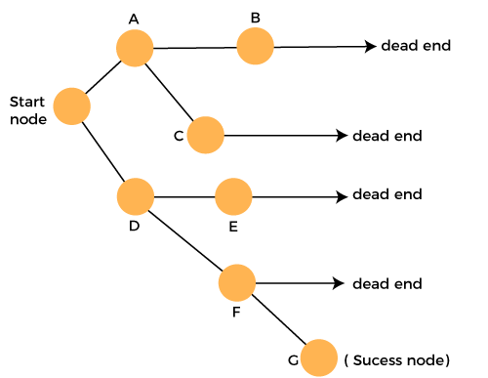
State space tree
Applications
N-queen problem
Sum of subset problem
Graph coloring
Hamiliton cycle

Slide 8
n-queen problem
The n-queens problem is a generalization of the 8-queens problem.
n queens are to be placed on an n x n chessboard so that no two queens under attack, i.e., no two queens are on the same row, column or diagonal.
The solution space consists of all n! permutations of the n-tuple (1, 2, ... , n).
Tree organization for the case n = 4/8.
Organization tree is called a permutation/state space tree.
The edges are labeled by possible values of x.

Slide 9
4-queen problem
The 4-queens problem is a problem of placing the 4-queens on 4x4 chessboard.
So that no two queens are under attack, i.e., no two queens are on the same row, column or diagonal.
Find all the possible arrangement/solution that solves given constraint/bounding function.
Possible solutions are 16C4.
Solutions represents with tree called as state space tree.
The edges are labeled by possible values of x.

Slide 10
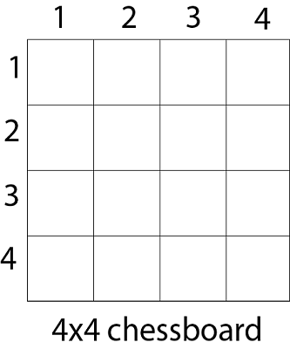
4 queens problem
Given a 4 x 4 chessboard.
Number the rows and column of the chessboard 1 through 4.

Slide 11
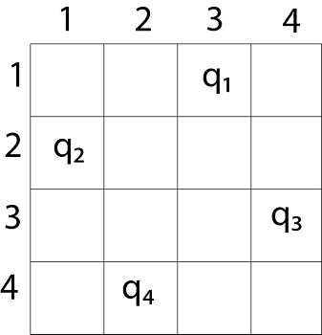
Solution
The other solutions for 4 - queens problems is (3, 1, 4, 2)
Column number- [3, 1, 4, 2]
Another solution for 4 - queen problem is (2, 4, 1, 3)

Slide 12
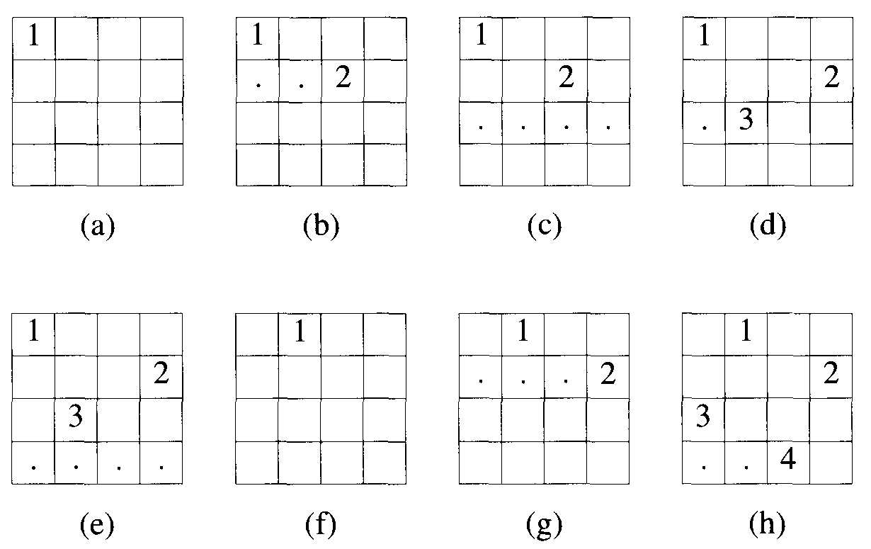
Example of backtrack solution to the 4 queens problem

Slide 13
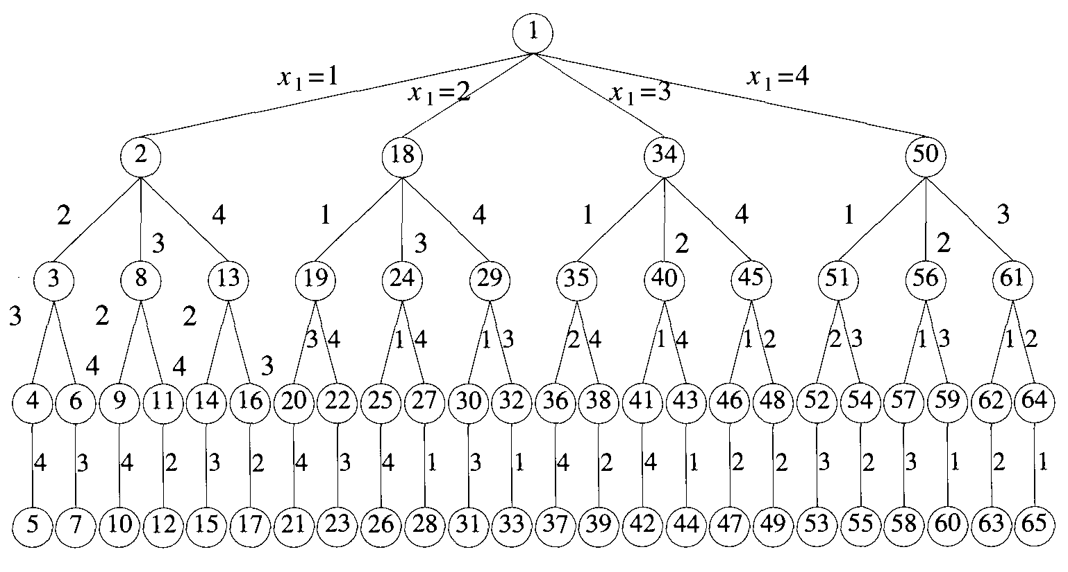
State space tree without attack

Slide 14
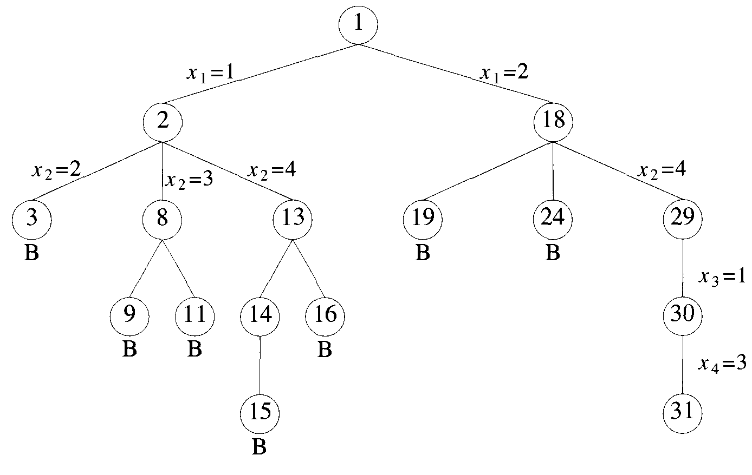
State space tree with attack

Slide 15
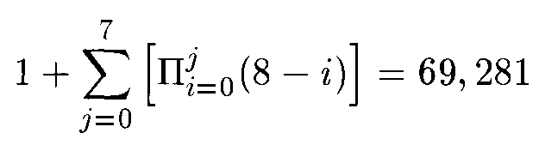
8-queen problem
The 8-queens problem is a problem of placing the 8-queens on 8x8 chessboard.
So that no two queens are under attack, i.e., no two queens are on the same row, column or diagonal.
Find all the possible arrangement/solution that solves given constraint/bounding function.
Possible ways are 64C8.
Solutions represents with state space tree.
The no. of nodes in the
8-queens state space tree is-

Slide 16
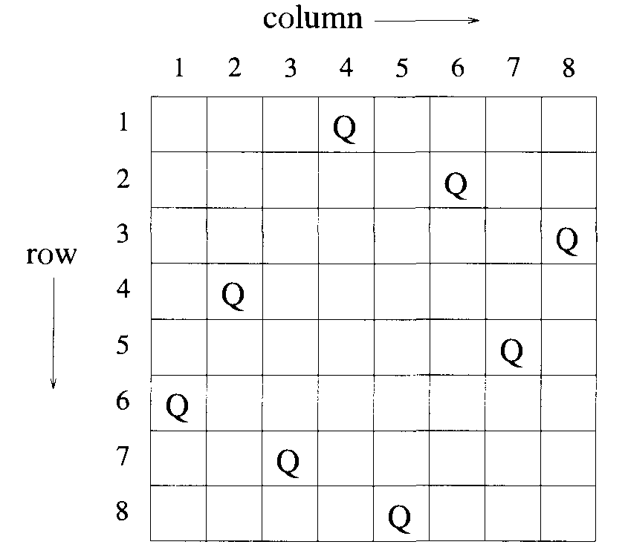
Solution x=(4,6,8,2,7,1,3,5)

Slide 17
Traveling-salesman Problem
In the traveling salesman Problem,
  A salesman must visits n cities.
  Salesman wishes to make a tour by visiting each city exactly once and finishing at the city he starts from.
  There is a non-negative cost c (i, j) to travel from the city i to city j.
  The goal is to find a tour of minimum cost.
  In it every two cities are connected.
  Such problems are called Traveling-salesman problem (TSP).

Slide 18
Traveling-salesman Problem
Problem Statement
  A traveling salesman needs to visit all the cities from a list, where distances between all cities are known and each city should be visited just once.
  What is the shortest possible route that he visits each city exactly once and returns to the origin city?
Objective
  To find the shortest/minimum path/route that visits every vertex exactly once and returns back to the starting point.
  Path should be faster, shorter and cheaper.
  To find a tour of minimum cost c(i, j).

Slide 19
For n number of vertices in a graph, there are (n - 1)! number of possibilities.
Time complexity is O((n-1)!) = O(n!)
Consider a graph G = (V, E),
where V is a set of cities and
E is a set of weighted edges.
An edge e(u, v) represents that vertices u and v are connected.
Distance between vertex u and v is d(u, v).
Let u, v, w be any three vertices, we have cost
c(u, w) <= c(u, v) +c(v, w)

Slide 20
Formula-
Cost of node is denoted as cost c (i)
Cost(i, s, j) represents the distance from i to j and s as an intermediate city.
Distance by visiting o city as intermediate city.
S = Φ
Cost(2,Φ,1)=d(2,1)
Distance by visiting 1 city as intermediate city.
S = 1
cost{2, {3}, 1} = d[2, 3] + Cost(3, Φ, 1)

Slide 21
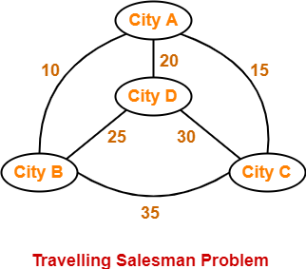
Example
If salesman starting city is A, then a TSP tour in the graph is-
A → B → D → C → A
Cost of the tour
= 10 + 25 + 30 + 15
= 80 units

Slide 22
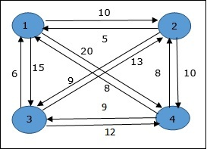
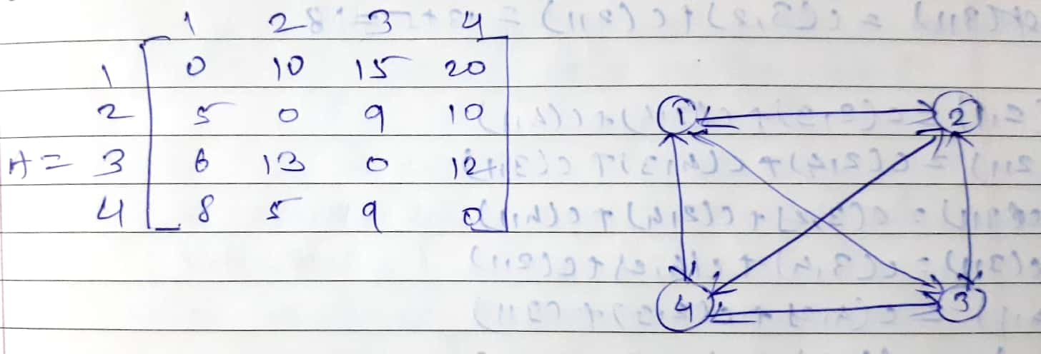
Example

Slide 23
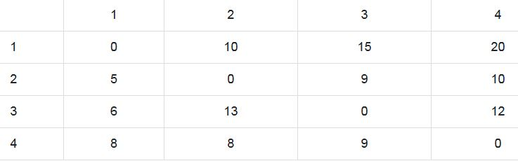
Example-2

Slide 24
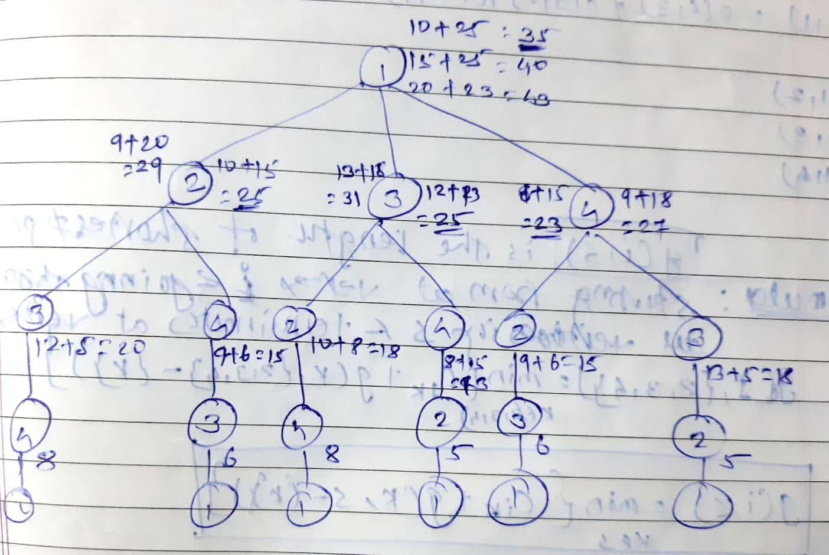
Shortest path with minimum cost is (1, 2, 4, 3, 1)

Slide 25
NP Hard and NP Complete Problems

Slide 26
NP Hard and NP Complete Problems
Contents:
Basic Concepts
Introduction to NP Hard Graph Problems.

Slide 27
Basic Concepts
The computing times of algorithms fall into two groups
  Computing in Polynomial time
  Computing in Exponential /Non-Polynomial time.
Polynomial time-
Problems whose solutions are bounded by the polynomial of small degree (Less time).
Exponential /Non-Polynomial time-
Problems whose best known solutions are bounded by non polynomial time (Large time)

Slide 28
Polynomial time-
Example –
  Linear search O(n)
  Binary search O(log n)
  Merge sort O(nlog n)
  Insertion Sort O(n^2)
  matrix multiplication O(n^3)
Exponential Time-
0/1 Knapsack problem- O(2^n)
Traveling Salesperson problem- O(2^n)

Slide 29
Algorithms
Deterministic Algorithm
  Result of every operation is uniquely defined.
  Algorithm with this property is termed as Deterministic algorithm.
Non-Deterministic Algorithm
  Operations whose outcomes are not uniquely defined but are limited to specified set of possibilities.
  The machine executing such operations are allowed to choose any one of these outcomes subject to a termination condition.

Slide 30
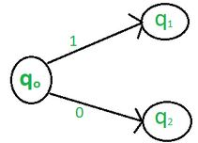
Deterministic Algorithm
For a particular input the algorithm will give always same output.
Result of every operation is uniquely defined
Can solve the problem in polynomial time.
Can determine the next step of execution.

Slide 31
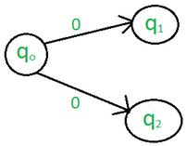
Non-Deterministic Algorithm
For a particular input the algorithm will give different output on different execution.
  Operations whose outcomes are not uniquely defined.
Can’t solve the problem in polynomial time.
Cannot determine the next step of execution due to more than one path the algorithm can take.

Slide 32
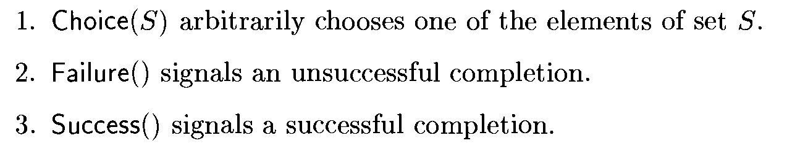
Non-Deterministic Algorithm
To specify such algorithms, we introduce three functions/statements:
  Deterministic Algorithm leads to a successful completion then one set of choices is always made and the algorithm terminates.
A non deterministic algorithm terminates unsuccessfully if and only if there exists no set of choices leading to a successful signal

Slide 33
Non-Deterministic Algorithm
j= choice(a, n)
if(A[j]==x) then
{
write(j);
success();
}
write(0);
failure();

Slide 34
Basic Concepts
P is set of problems that can be solved by a deterministic algorithm in Polynomial time.
NP is set of decision problems that can be solved by a Non-deterministic algorithm in Polynomial time.
Decision problem: Any problem which the answer is either zero or one is called decision problem.
An algorithm which for decision problem is termed as decision algorithm.
P is subset of NP.

Slide 35
NP Hard and NP Complete
NP- Any problem that can be solved by deterministic machine in polynomial time can also be solved by non-deterministic machine in polynomial time.
NP-hard: The class of problems to which every NP problem reduces.
NP-complete (NPC): the class of problems which are NP-hard and belong to NP.

Slide 36
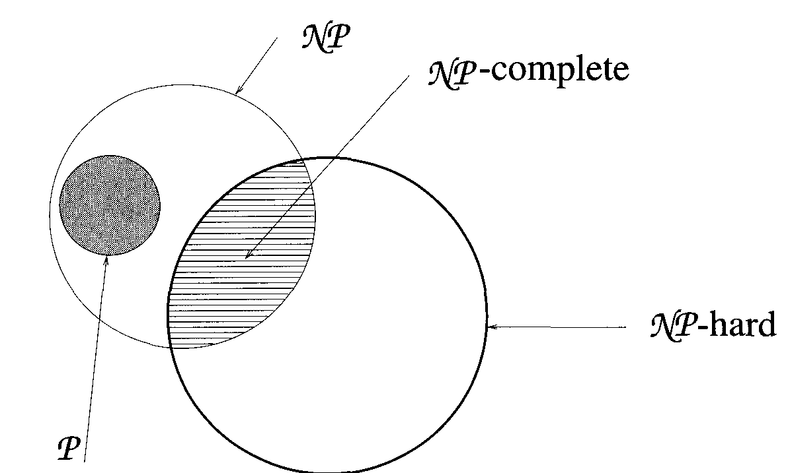
Relationship among P, NP, NP Hard & NP Complete

Slide 37
Satisfiability
Boolean Satisfiability
  Denoted as SAT
  It is boolean formula.
  It is the problem of determining if a Boolean formula is satisfiable or unsatisfiable.
Satisfiable :
  If the Boolean variables can be assigned values such that the formula turns out to be TRUE, then we say that the formula is satisfiable.
Unsatisfiable :
  If it is not possible to assign such values, then we say that the formula is unsatisfiable.

Slide 38

Satisfiability
CNF :
  Conjunctive Normal Form (Product of Sums (POS))
  CNF is a conjunction (AND) of clauses, where every clause is a disjunction (OR).
  Formula is CNF iff it is represented as
2-CNF
  Boolean formula expressed as a CNF with every clause having only 2 terms.
  CNF with each clause having only 2 terms.
  Assign such values to the variables so that the CNF is TRUE.

Slide 39


Satisfiability problem is to determine whether a formula is true for some assignment of truth values to the variables.
Reduces:
  Let L1 & L2 be two problems.
  Problem L1 reduces L2
  iff there is a way to solve L1 by deterministic polynomial time algorithm that solves L2 in polynomial time.
  Polynomial time algorithm for L2, the we can solve L1 in polynomial time.

Slide 40



NP Hard and NP Complete
Problem L is NP-Hard iff satisfiability reduces to L
Problem L is NP-Complete iff
Two problems L1 & L2 are said to be equivalent iff

Slide 41
NP-Hard Graph problem
Clique Decision Problem
It is NP-Hard Graph problem.
Before Clique Decision problem, following things to be discussed:
  What is Clique?
  What are Decision problem & Optimization problem?
  What are NP-Hard Graph problem?
  Procedure to prove NP-Hard.
  Prove Clique Decision problem (CDP) is NP-hard.

Slide 42
What is Clique?
  It is complete sub-graph of graph G=(V,E), is called as Clique.
  It is subsets of vertices, all adjacent to each other in a complete graph.
  In Clique, every vertex is directly connected to another vertex.
  The number of vertices in the Clique represents the Size of Clique i.e. k.
  K is size of clique.

Slide 43
  Decision problem
    Problem having answer either true or false is called as decision problem.
    Find if a graph having a clique of size k.
  Optimization problem
    Any problem that involves identification of optimal values of given cost function is known as Optimization problem
    Find max clique of size k in a graph.
    Optimization algorithm is used to solve Optimization problem.

Slide 44
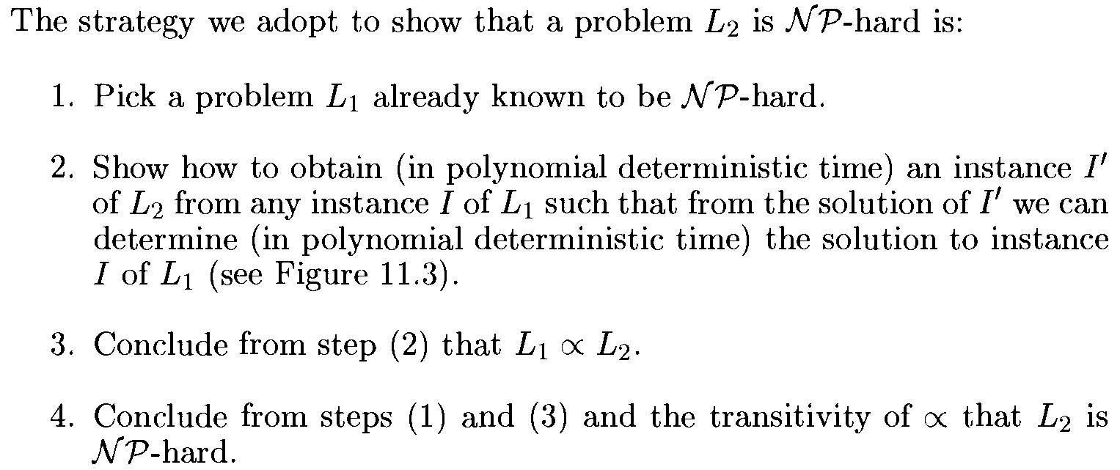
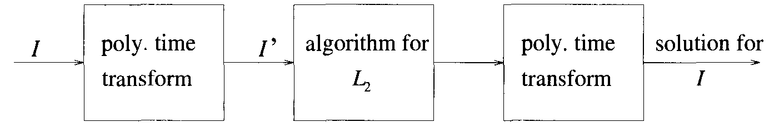
NP-Hard Graph Problem

Slide 45
End of Unit-6

